Slide 1
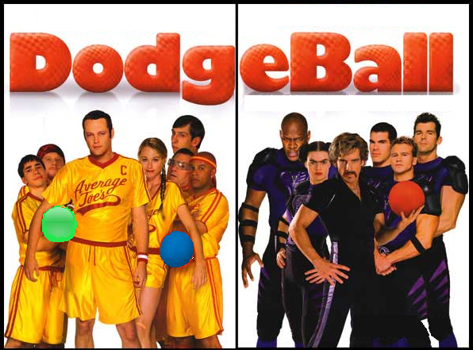
COME PLAY DODGEBALL WITH A DIFFERENT HUE!
HUE KNEW
Could be this fun?
The Reynolds Center
Feb 26 - 9p.m.
Sponsored by Clippers After Dark

